Slide 1
CAR MANIA
A Software Development Project
CSE 1200: Software Development-I
Department of Computer Science and Engineering
Ahsanullah University of Science and Technology

Slide 2
CREDITS
Project Advisors
Golam Muktaadir sir & Anik Chowdhury sir
Project Members
190104016 Mainul Islam
190104019 Abdur Rahim
190104020 Abdullah Al Sajid
190104024 Abdullah Al Mamun

Slide 3
FEATURES - I
Player
Player can move front/back/left/right direction
Boost
Player can boost up car’s speed by pressing ‘SPACE’
At most 5 boost up in one gameplay
No damage during boost !!!
Life
At starting there will be total 5 lives
There is chance to collect extra life while life condition is poor

Slide 4
FEATURES - II
Level
After a certain distance level will be increased as well as opponents' speed will also be increased
Score
Golden coin will be counted as 20 points
Silver coin will be counted as 10 points
Boost time damage will be converted to 30 points
The main purpose of playing this game is to collect as many coin as possible without losing life.

Slide 5
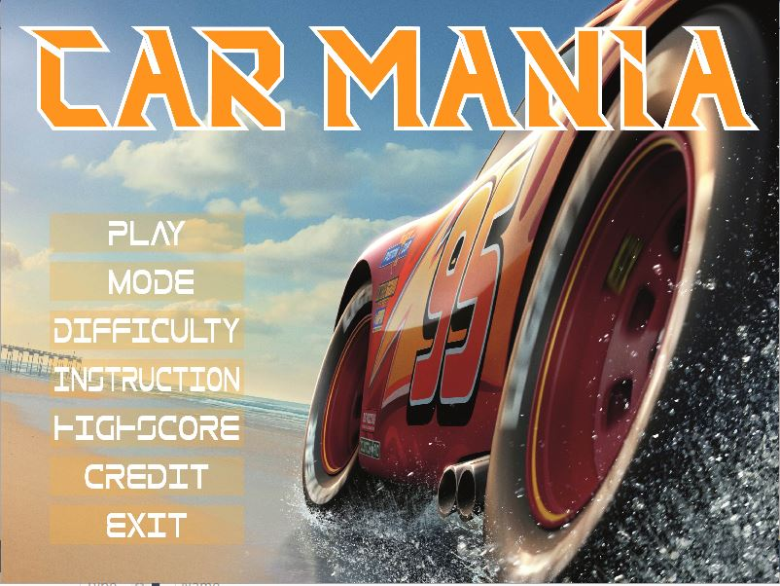
FEATURES - III
Menu
PLAY
MODE
DIFFICULTY
INSTRUCTION
HIGH-SCORE
CREDIT
EXIT

Slide 6
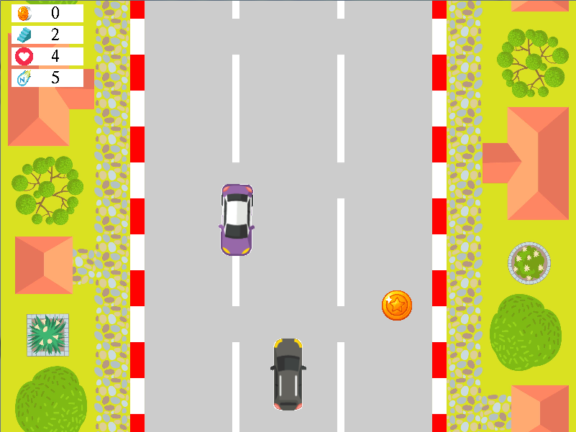
FEATURES - IV
Play
Gaming Background

Slide 7
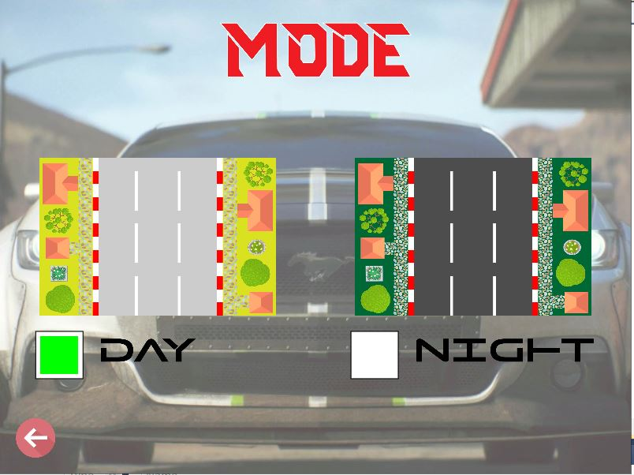
FEATURES - V
Mode
Player can select Day mode or Night mode from mode menu

Slide 8
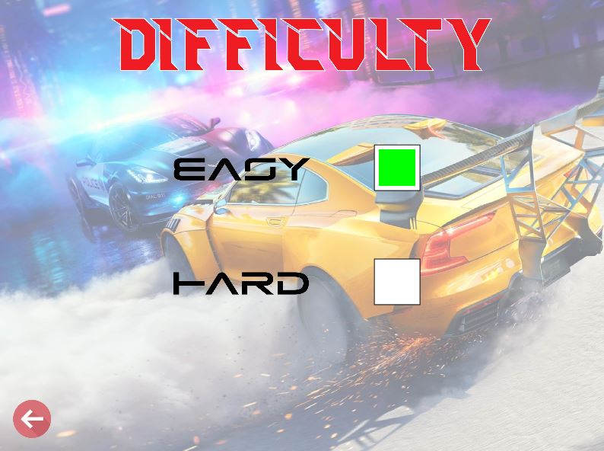
FEATURES - VI
Difficulty
Player can select Easy or Hard at difficulty menu

Slide 9
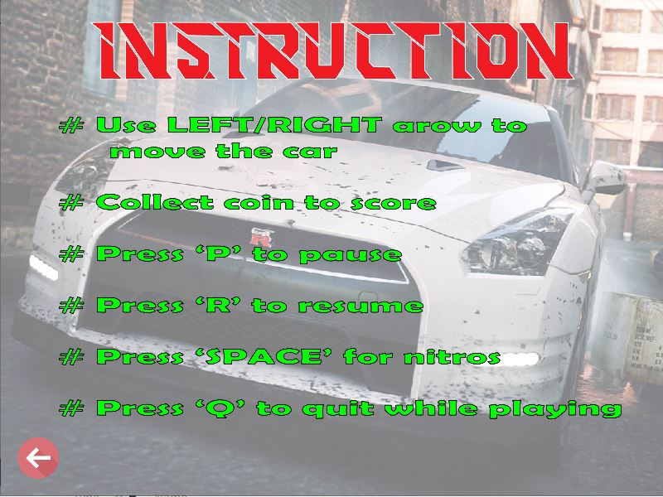
FEATURES - VI
Instruction
Press ‘P’ to pause the game while playing
Press ‘R’ to resume the game while playing
Press ‘Q’ to leave the game while playing

Slide 10
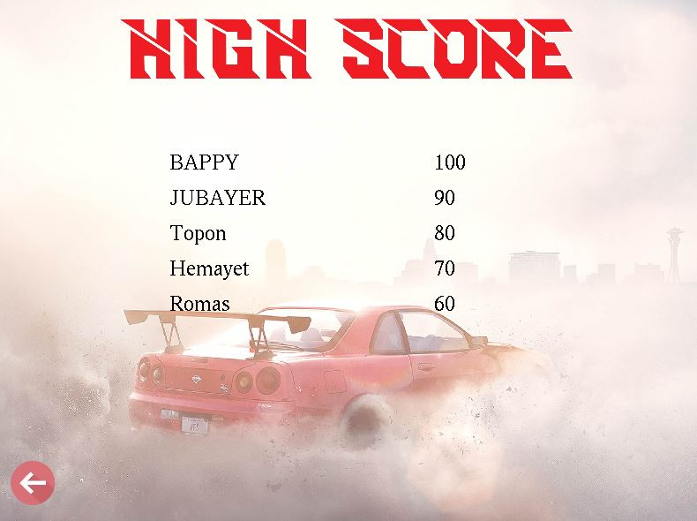
FEATURES - VII
High score
Player can visit top 5 players score from high score page

Slide 11
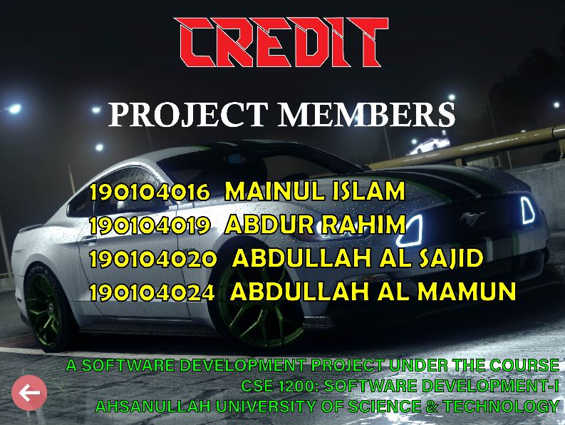
FEATURES - VIII
Credit

Slide 12
Thank you

